Slide 1



A novel split-merge-evolve k clustering algorithm

Slide 2
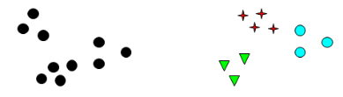
content
K Clustering algorithms
K-means clustering
Bisecting k-means clustering
Agglomerative hierarchical clustering
Split-merge-evolve K clustering
Algorithm
Advantages
Evaluation

Slide 3
clustering
Many existing algorithms
Efficiency depends on fit between algorithm and datasets
We propose a new flexible clustering algorithm
Simple, Flexible and Efficient
Similar to existing k-means and agglomerative hierarchical clustering
Flexible implementation (centroid-based, linkage-based, etc.).
Towards to user-defined or expected clustering result.
Ability to optimize the result when new data is added dynamically to the clusters (in our use case)

Slide 4
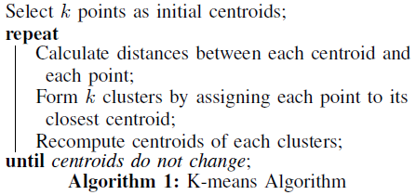
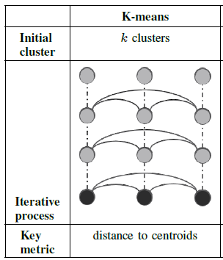
K-means Existing clustering algorithms
Randomly chooses k initial centroids
Assigns data vectors to clusters and re-calculates centroids until centroids do not change any more
Key metric is the distance between centroids and data vectors
Manhattan distance, Euclidian distance, etc.

Slide 5
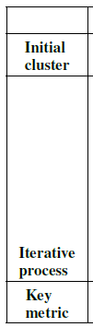
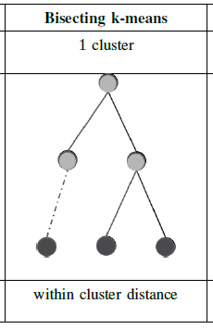
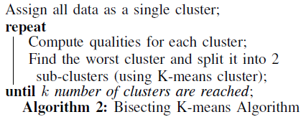
Bisecting k-means Existing clustering algorithms
Starts with 1 cluster
Iteratively picks the worst cluster to split until k clusters are formed
Key measure is the quality of a cluster
E.g., within cluster median distance

Slide 6
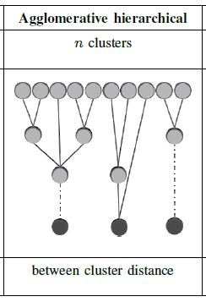
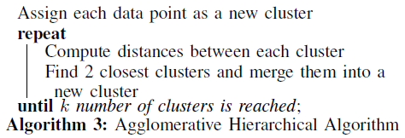
Agglomerative hierarchical clustering Existing clustering algorithms
Starts with singleton clusters
Keeps merging pairs of closest clusters in a tree structure until k clusters are formed
Key metric is the distance between clusters
E.g., Ward’s or link-based method

Slide 7
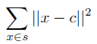
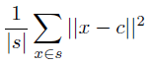
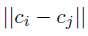
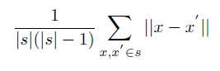
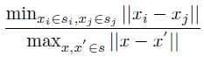
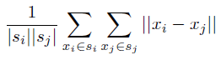
Split-merge-evolve
Randomly initialises K clusters
Split
measure the quality of clusters to decide which to split into 2 (or more)
Key measure: quality of cluster,
e.g.
or
Merge
find 2(or more) clusters with closest distance between them and merge them
Key measure: distance between clusters,
e.g.
or
Evolve
evolve the final result towards the user defined measure
Key measure: quality measure (may require additional analysis of problem)
e.g.,
or
Selected one of the top largest clusters as the worst cluster, where split and merge work on the same clusters

Slide 8
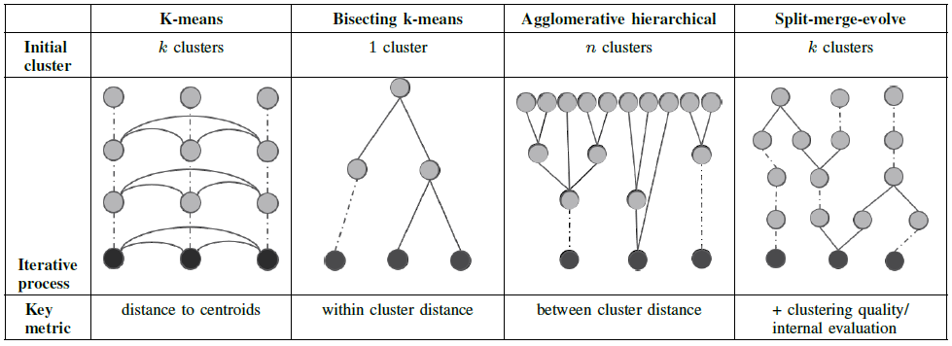
Comparison
Split-merge-evolve
Key metrics for each step in iteration:
+quality of cluster/user-defined quality measure
Toward to User-defined quality measure for the expected clustering results

Slide 9
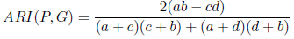
Evaluation
Evaluation Dataset
2 Artificial Datasets
2 Real life Datasets
Evaluation Metric
Adjusted Rand Index (ARI)
Similarity between the clustering algorithm output P and clustering ground truth G
Notes:
where a is for data vectors in the same class both in P and
G, b is data vectors in the same class in P, but different
classes in G. c is data vectors in different classes in P, but
in the same class in G. d is data vectors in different classes
both in P and G.

Slide 10
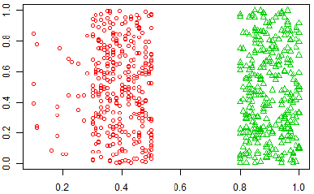
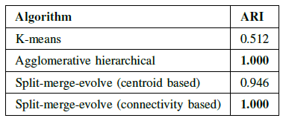
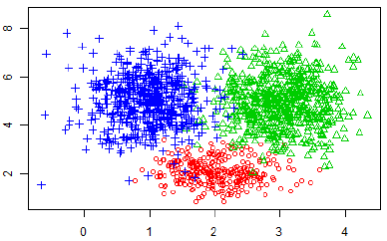
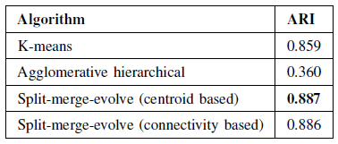
evaluation
Data set 1- Artificial
Clear boundaries between classes
Data set 2 - Artificial
No clear boundaries between classes
Results : avg ARI over 20 runs

Slide 11
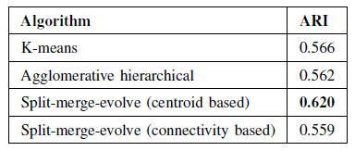
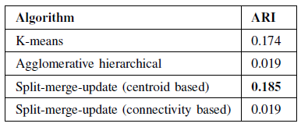
evaluation
Dataset 3 - Real life
3 classes of Iris flowers dataset, 4 attributes
Dataset 4 - Real life
US forensic science service, 6 classes of glasses, 9 attributes
Results : avg ARI over 20 runs

Slide 12
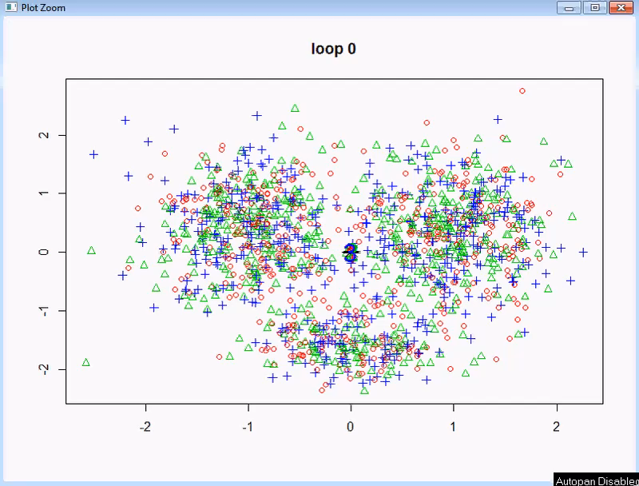
split-merge-evolve in action (DEmo)
Dataset 2
<- Click left demo video to play

Slide 13
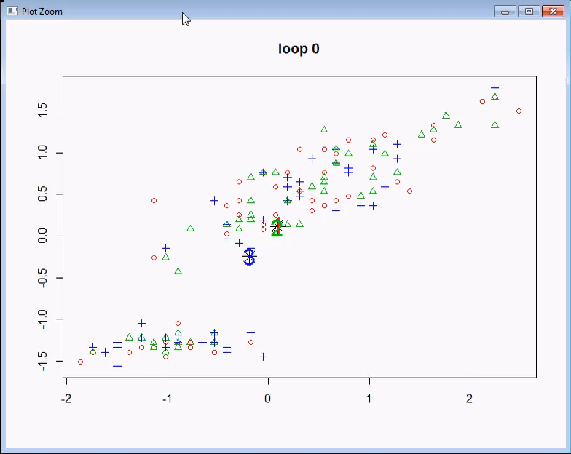
split-merge-evolve in action (DEmo)
Dataset 3 - Iris
<- Click left demo video to play

Slide 14
A novel Split-merge-evolve k clustering algorithm
The Fourth IEEE International Conference on Big Data Computing Service and Applications, 2018
https://ieeexplore.ieee.org/document/8405716/

